Slide 1





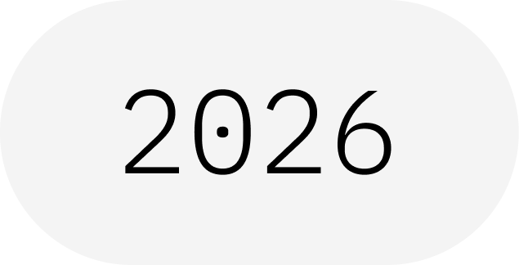
Qiskit Patterns
Map · Optimize · Execute · Post-process
IBM Quantum School
Saad Ejaz • Guest Speaker
Qiskit Fall Fest 2026 at University of Engineering & Technology Lahore,Narowal Campus

Slide 2
01
SPEAKER INTRODUCTION
Saad Ejaz
Guest Speaker
Computer Engineering student and IBM Quantum School tutor, introducing Qiskit patterns as a four-step workflow from problem to result.
IBM Quantum School
Qiskit Fall Fest 2026 at University of Engineering & Technology Lahore,Narowal Campus

Slide 3
02
TABLE OF CONTENTS
01
Why Qiskit Patterns
02
The Four-Step Workflow
03
Map & Optimize
04
Execute & Post-process
05
Qiskit Implementation
06
Takeaways & Resources
Qiskit Fall Fest 2026 at University of Engineering & Technology Lahore,Narowal Campus

Slide 4

WHAT IS A QISKIT FALL FEST?
03
A beginner-friendly session on Qiskit patterns: a four-step workflow that takes a problem from idea to result.
Qiskit Fall Fest 2026 at University of Engineering & Technology Lahore,Narowal Campus

Slide 5
04
INTRODUCTION
01
Qiskit Fall Fest 2026 at University of Engineering & Technology Lahore,Narowal Campus

Slide 6
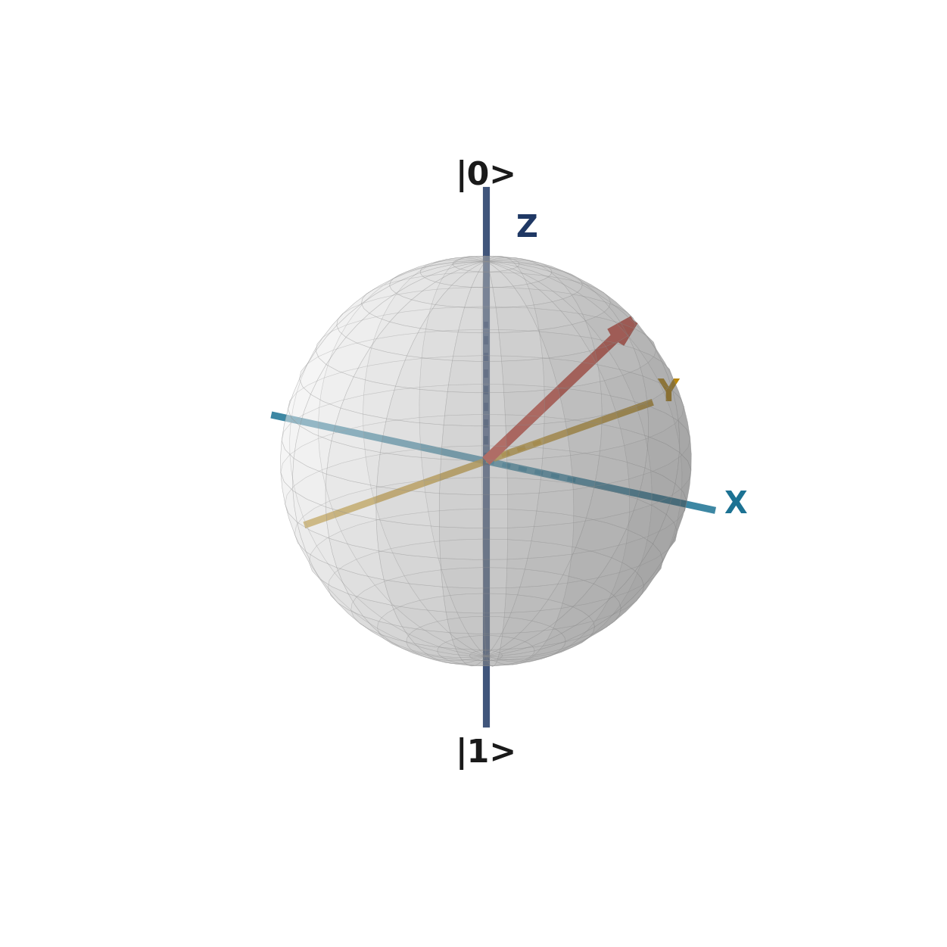
05
WHY QISKIT PATTERNS?
Useful quantum work takes more than a circuit.
REAL-WORLD PROBLEM
A Qiskit pattern is a repeatable workflow that takes a problem from classical input to a final answer, using quantum and classical tools together.
Each stage stays separate, so you can improve one step without rewriting the others.
QISKIT PATTERN
USEFUL RESULT
Qiskit Fall Fest 2026 at University of Engineering & Technology Lahore,Narowal Campus

Slide 7
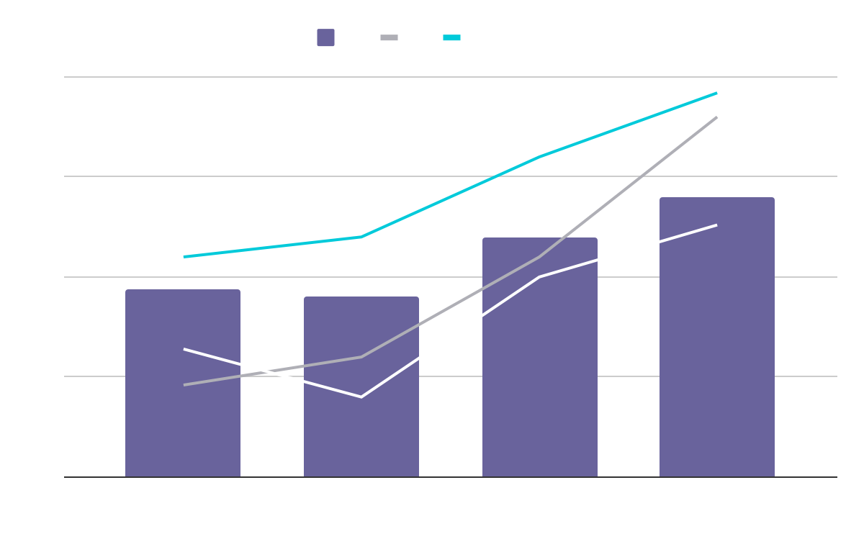
THE FOUR STEPS AT A GLANCE
01
02
03
04
Map
Optimize
Execute
Post-process
Translate the problem into quantum circuits and operators.
Transpile the circuits for a specific quantum device.
Run the circuits on IBM hardware or a simulator with Qiskit Runtime.
Analyze the results and apply error mitigation to get the answer.
Together, these four steps make a Qiskit pattern.
Qiskit Fall Fest 2026 at University of Engineering & Technology Lahore,Narowal Campus

Slide 8
07
THE FOUR STEPS
02
Qiskit Fall Fest 2026 at University of Engineering & Technology Lahore,Narowal Campus

Slide 9
08
STEP 1: MAP
Translate the problem into something a quantum computer can run.
CIRCUITS
OPERATORS
ABSTRACT VIEW
Gates on qubits
What to measure
Any device
Encode the problem as a quantum circuit built from gates.
Define the observables, such as Pauli operators, that you want to estimate.
At this stage, nothing depends on a specific quantum device.
Qiskit Fall Fest 2026 at University of Engineering & Technology Lahore,Narowal Campus

Slide 10
09
STEP 2: OPTIMIZE
BEFORE
AFTER
An abstract circuit that assumes any qubit can talk to any other qubit.
A shorter circuit rewritten for the chosen device, using its native gates and qubit connections.
KEY POINT
Qiskit's transpiler does this for you. Optimization levels 0 to 3 trade compile time for a better circuit.
Qiskit Fall Fest 2026 at University of Engineering & Technology Lahore,Narowal Campus

Slide 11
10
STEP 3: EXECUTE
Run the optimized circuits on IBM Quantum hardware.
SAMPLER
Qiskit Runtime runs your circuits through primitives.
Choose a real device or a simulator.
More shots give more reliable statistics.
Returns the measured bitstrings and their counts.
ESTIMATOR
Returns expectation values of the observables you define.
Qiskit Fall Fest 2026 at University of Engineering & Technology Lahore,Narowal Campus

Slide 12
11
STEP 4: POST-PROCESS
ERROR MITIGATION
ANALYSIS
Reduce the effect of hardware noise on your results.
Use classical code to turn raw data into expectation values and other metrics.
VISUALIZATION
ITERATE
Plot counts and values to see what the results mean.
Use the answer to refine the problem and run the pattern again.
Qiskit Fall Fest 2026 at University of Engineering & Technology Lahore,Narowal Campus

Slide 13
12
IMPLEMENTATION
03
Qiskit Fall Fest 2026 at University of Engineering & Technology Lahore,Narowal Campus

Slide 14
13
QISKIT PATTERN IN CODE
EXAMPLE: BELL STATE
# 1. MAP: circuit + observable
qc = QuantumCircuit(2)
qc.h(0); qc.cx(0, 1)
obs = SparsePauliOp("ZZ")
# 2. OPTIMIZE: transpile for the backend
service = QiskitRuntimeService()
backend = service.least_busy(simulator=False, operational=True)
pm = generate_preset_pass_manager(
optimization_level=3, backend=backend)
isa_qc = pm.run(qc)
isa_obs = obs.apply_layout(isa_qc.layout)
# 3. EXECUTE: run with the Estimator primitive
job = EstimatorV2(mode=backend).run([(isa_qc, isa_obs)])
# 4. POST-PROCESS: read the expectation value
print(job.result()[0].data.evs)
One small example covering all four steps. Imports are omitted for space.
1 Map
2 Optimize
3 Execute
4 Post-process
Qiskit Fall Fest 2026 at University of Engineering & Technology Lahore,Narowal Campus

Slide 15
14
RESOURCES
IBM QUANTUM LEARNING
Qiskit patterns and the Qiskit SDK tutorials.
QISKIT DOCUMENTATION
Transpiler, Qiskit Runtime primitives, and error mitigation guides.
KEY TAKEAWAY
Map, Optimize, Execute, Post-process.
Qiskit Fall Fest 2026 at University of Engineering & Technology Lahore,Narowal Campus

Slide 16
THANKS!
DO YOU HAVE ANY QUESTIONS?
15
Saad Ejaz • Guest Speaker
IBM Quantum School
Qiskit Fall Fest 2026 at University of Engineering & Technology Lahore,Narowal Campus

